Slide 1
Chinook Project
Exploring Chinook Database & Strategy Analytics
Prepared By: Ansh Verma
Date: 13 December, 2025

Slide 2
Agenda
Introduction
Objectives
Database Schema and Data Description
Insights
Conclusion

Slide 3
Problem Statement
You are hired as a data analyst at Chinook, and your objective is to analyze music record sales data to gain insights and make recommendations for the company's strategy in the physical music market.

Slide 4
Introduction To Chinook
Leading Music Platform: Chinook is a recognized name in industry providing quality music to listeners.
Diverse Music Catalog: Offers a wide range of genres catering to wide range of audience.
Global Reach: Connects to customers with extensive international network.
Data Driven: Leverages customer and sales data to understand behavior and drive business growth.

Slide 5
Objectives
Analyze customer behavior across regions.
Understand purchasing trends and churn rates.
Determine top-selling tracks, artists, and genres in USA.
Recommend albums for promotion based on genre sales performance and customer preferences.

Slide 6
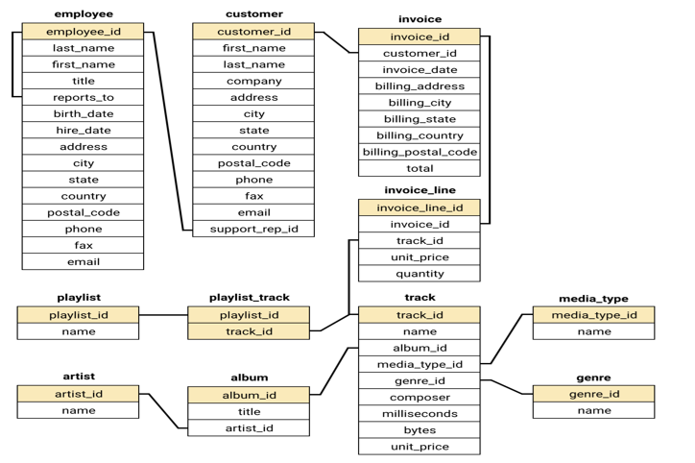
Database Schema

Slide 7
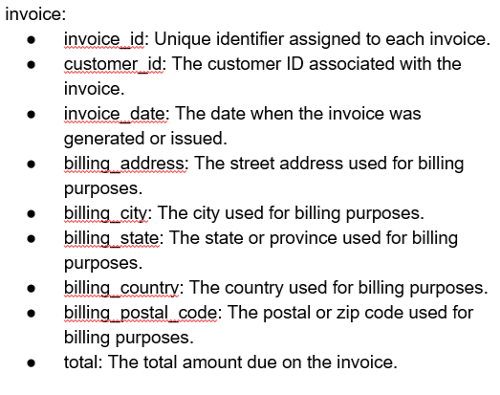
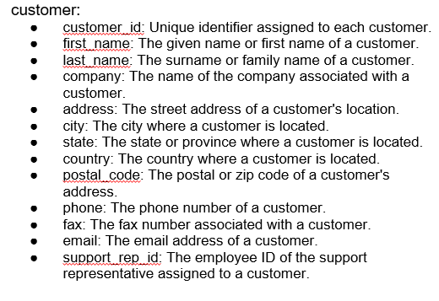
Data Description

Slide 8
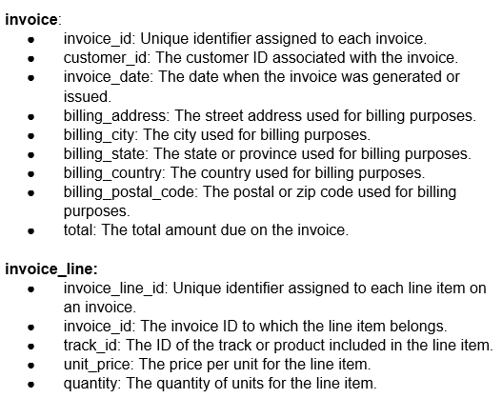
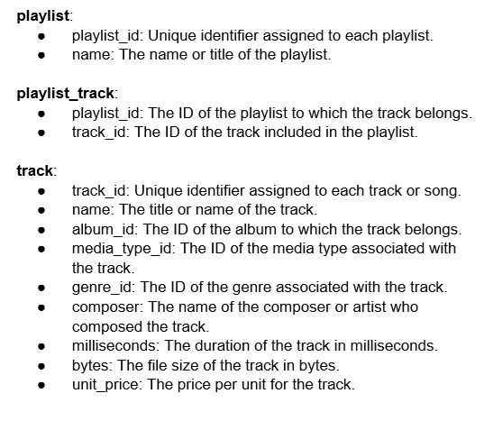
Data Description

Slide 9
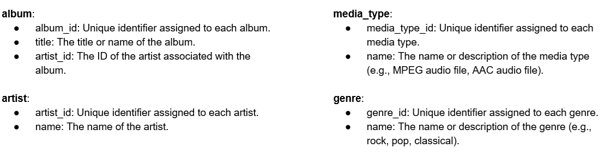
Data Description

Slide 10
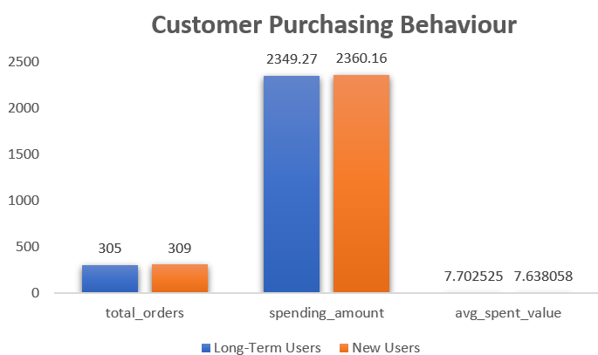
Customer Purchasing Behavior
Long term users placed 305 orders with total spend of 2349.27.
Short term user placed 309 orders, slightly higher with total spend of 2360.16
Average spend order value (7.70 for long term and 7.63 for short term.

Slide 11
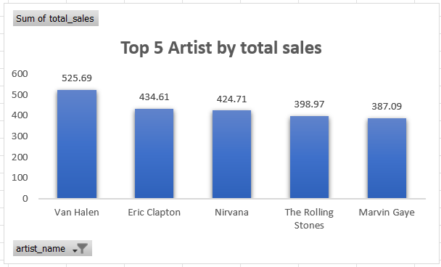
Top 5 Artist By Total Sales in USA
Top 5 artist name by sum of total sales are as follow:
Van Halen: 525.69
Eric Clapton: 434.61
Nirvana: 424.71
The Rolling Stones: 398.97
Marvin Gaye: 397.09

Slide 12
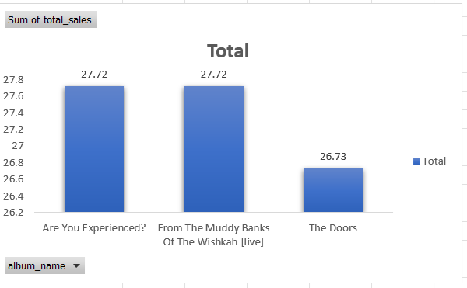
Top 3 albums in USA to prioritize for advertising
Rock is the leading genre in USA as shown consistently in top 3.
Due to proven sales these 3 albums are primary candidate for advertising.

Slide 13
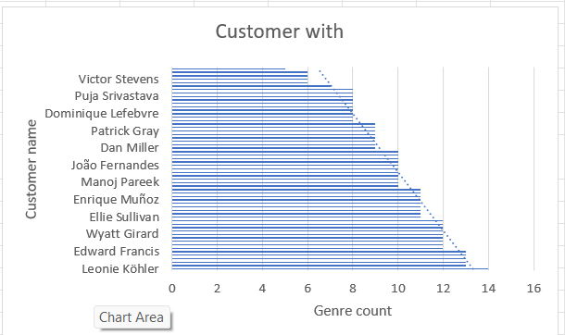
Customers who purchased tracks from at least 3 different genres
Leonie Köhler is the only one to purchase tracks from 14 different genres.
There are many customers with 13 unique genres.
Majority of the people lies in the range of 10-12, with a small group buying in the range of 5-9 unique genres.

Slide 14
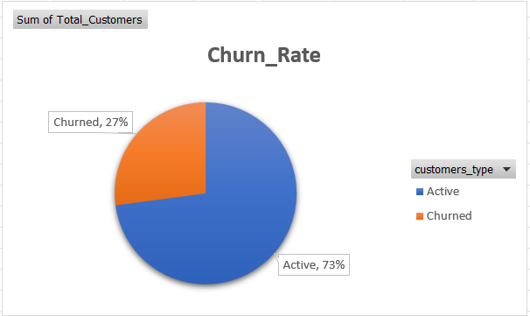
Customer Churn Rate
To analyze churn customer rate ,I defined churned customers as those who had not made a purchase within 6 Months.
With this data 27% of customer are giving churn rate.

Slide 15
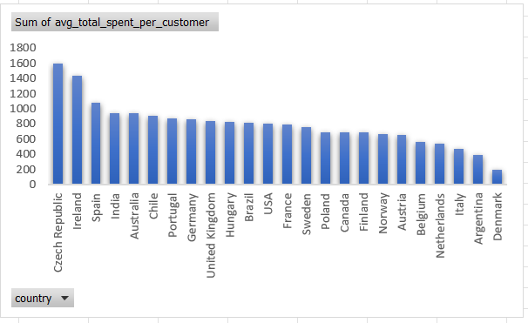
Average spending of per customer by country
Czech republic comes at the top of average spending per customer globally with a tally of 1591.92.
Denmark has the lowest spending per customer 196.02

Slide 16
Conclusion
Data Integrity: Prioritize maintaining accurate and up-to-date data to generate reliable insights that drive informed decision-making.
Customer Loyalty: Long term users exhibit higher lifetime value; new users represent growth opportunities via personalization.
Retention & Risk: High-Value customers require bespoke engagement; predictive modeling is recommended to mitigate churn.

Slide 17


